Slide 1

Intro to Computational Statistics
Day 6: Statistical Analysis Day 2

Slide 2

Questions?

Slide 3

Creating your own research project

Slide 4
General Procedure
Step 1: Come up with a research question or an idea you are curious about
Step 2: Look for datasets related to your question
Step 3: Revise your research question
Step 4: Think of an appropriate statistical method
Step 5: Program
Step 6: Get results and perform analysis
Step 7: Write a report and create a presentation

Slide 5
General Procedure
Step 1: Come up with a research question or an idea you are curious about
Step 2: Look for datasets related to your question
Step 3: Revise your research question
Step 4: Think of an appropriate statistical method
Step 5: Program
Step 6: Get results and perform analysis
Step 7: Write a report and create a presentation

Slide 6

Your turn!

Slide 7

Step 1: Come up with a research question or an idea you are curious about

Slide 8
What are you curious about?
WiFi use in different parts of people’s lives?
WiFi usage based on occupation/background?
Cost of auto insurance
Age, type of car, modifications
Polling vs. actual election results
Gender, age, socioeconomic statuses
Cost of electronic devices across different companies
Profit margins
Demographics and inflation
Stocks
Master’s and PhD education over time

Slide 9

Step 2: Look for datasets related to your question

Slide 10
Onto Kaggle!
https://www.kaggle.com/datasets/rkiattisak/graduation-rate

Slide 11
Step 3: Revise your research question

Slide 12
What should our revised research question be?
What are some features that can be used to predict if someone will graduate or not?
Is high school GPA correlated with college GPA?

Slide 13

Step 4: Think of an appropriate statistical method

Slide 14
What statistical methods should be use?
You are not limited to the methods we covered in class. Feel free to branch out!
For high school GPA vs. college GPA, perform linear regression
Predictor (independent variable): high school GPA
Could also include SAT/ACT scores
Response (dependent variable): college GPA
Factors that predict graduation
Linear regression
Analysis of Variance (useful when you have discrete outputs, such as years to graduate)

Slide 15

Step 5: Program

Slide 16
Onto Colab!
We will likely not have a complete program, but we can at least get a general idea of what the program should do…
Today, we have a complete program!
Similar to Day 4 program

Slide 17

Step 6: Get results and perform analysis

Slide 18
Statistical Interpretation
Shortcut: If the confidence interval includes 0, then the parameter is not statistically significant
Model:
Predicted: College GPA
Predictors: Years, Parental Income, HS_GPA
Significant positively correlated predictors: parental income and high school GPA
Significant negatively correlated predictor: years to graduate

Slide 19
Practical Interpretation
Financial inequality in college
More comfortable → more time to focus on academics → higher GPA
Years in college negatively correlated with college GPA
Low GPA → need for GPA boosters or switching majors → more years?
More years in college → more time exploring → more likely to take difficult classes → lower GPA?
Able to complete college quickly → more capable student, less likely to burn out, and less opportunity to take difficult class → higher GPA?
High school GPA positively correlated with college GPA
Do well in high school → more academically prepared → higher GPA
May be more interested in how strong this correlation/effect is

Slide 20

Step 7: Write a report and create a presentation

Slide 21

Disclaimer
We won’t be able to write a full report/presentation, but we will create a general outline and go over guidelines

Slide 22


What goes in a report?

Slide 23
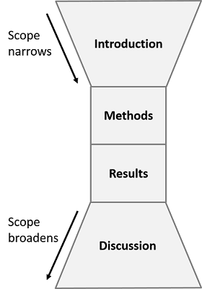
Why does this work?
Because it makes sense!
A good report is familiar and easy to follow
Unless you are writing specifically about the mathematics, your goal is to put the statistics in context
Notes:
From Day 2

Slide 24
Why does this work?
Because it makes sense!
A good report is familiar and easy to follow
Unless you are writing specifically about the mathematics, your goal is to put the statistics in context
We will look into various methods next week
We will focus primarily on results and discussions today

Slide 25
Scientific Report Structure
Title

Slide 26
Scientific Report Structure
Title
Abstract
Written last and gives a brief summary of the entire report

Slide 27
Scientific Report Structure
Title
Abstract
Written last and gives a brief summary of the entire report
Introduction/Background
Highlights current progress in the field you are studying
Identifies a gap and/or motivates your project

Slide 28
Scientific Report Structure
Title
Abstract
Written last and gives a brief summary of the entire report
Introduction/Background
Highlights current progress in the field you are studying
Identifies a gap and/or motivates your project
Methods
What experiment you performed

Slide 29
Scientific Report Structure
Title
Abstract
Written last and gives a brief summary of the entire report
Introduction/Background
Highlights current progress in the field you are studying
Identifies a gap and/or motivates your project
Methods
What experiment you performed
Results
The results of your experiment with analysis

Slide 30
Scientific Report Structure
Title
Abstract
Written last and gives a brief summary of the entire report
Introduction/Background
Highlights current progress in the field you are studying
Identifies a gap and/or motivates your project
Methods
What experiment you performed
Results
The results of your experiment with analysis
Discussion
Interpretation of your results
The “so what” portion

Slide 31
Scientific Report Structure
Title
Abstract
Written last and gives a brief summary of the entire report
Introduction/Background
Highlights current progress in the field you are studying
Identifies a gap and/or motivates your project
Methods
What experiment you performed
Results
The results of your experiment with analysis
Discussion
Interpretation of your results
The “so what” portion
Conclusion
Summary of your project
Call to action and/or future research

Slide 32
Scientific Report Structure
Title
Abstract
Written last and gives a brief summary of the entire report
Introduction/Background
Highlights current progress in the field you are studying
Identifies a gap and/or motivates your project
Methods
What experiment you performed
Results
The results of your experiment with analysis
Discussion
Interpretation of your results
The “so what” portion
Conclusion
Summary of your project
Call to action and/or future research
References
Citations

Slide 33
Scientific Report Structure
Title
Abstract
Written last and gives a brief summary of the entire report
Introduction/Background
Highlights current progress in the field you are studying
Identifies a gap and/or motivates your project
Methods
What experiment you performed
Results
The results of your experiment with analysis
Discussion
Interpretation of your results
The “so what” portion
Conclusion
Summary of your project
Call to action and/or future research
References
Citations
Appendix
Any extra figures/information

Slide 34
Scientific Report Structure
Focus for today
Title
Abstract
Written last and gives a brief summary of the entire report
Introduction/Background
Highlights current progress in the field you are studying
Identifies a gap and/or motivates your project
Methods
What experiment you performed
Results
The results of your experiment with analysis
Discussion
Interpretation of your results
The “so what” portion
Conclusion
Summary of your project
Call to action and/or future research
References
Citations
Appendix
Any extra figures/information

Slide 35
Methods
Explains what you did during the experiment and how you analyzed the data
What did we do in the project?

Slide 36
Methods
What did we do in this project?

Slide 37
Results
Highlight key findings
Do not need to give every detail, but enough to cover all the major components of your project
Good data + Good methods = Good results

Slide 38
Results
What did we learn from this project?

Slide 39
Discussion
The “so what” portion of your project
Explains why your project and results matter
Makes clear the implications of your findings

Slide 40
Discussion
Why do our results matter?

Slide 41
Why is outlining before drafting important?
Gives you a sense of direction and a road map
Easy to change outline and generate bullet points
Easy to communicate with others for feedback

Slide 42
Example reports
https://www.reed.edu/writing/paper_help/labreport_good.html
https://www.hamilton.edu/documents/Sample%20Bio%20Lab%20Report.pdf
http://writing.engr.psu.edu/workbooks/labreport2.html

Slide 43

How to create a presentation?
Presentations can come in various formats
Present slides
Present a poster
Present just the abstract
Best advice: look at other presentations/posters and go to research conferences
Idea: Keep it simple and straight-foward

Slide 44
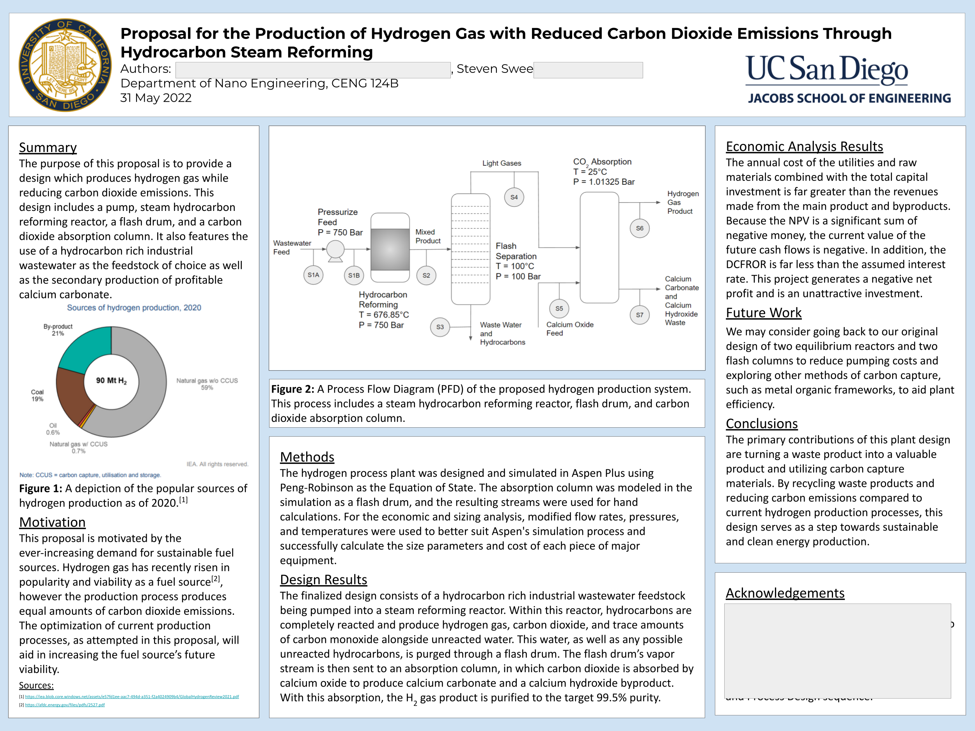
Notes:
Names omitted for privacy

Slide 46
Example slides
https://github.com/stswee/InclusiveDataHackathon

Slide 47

What to do next?

Slide 48

Mini-Project 5/6
These two mini-projects are like a “capstone” for the course
You’ll combine everything you’ve learned so far (and before the class) and perform a statistical experiment using data that is already available online

Slide 49
Mini-Project 5
Equivalent to Steps 1-5 in the procedure
Requires some programming for Step 5
Feel free to look up tutorials online or review previous mini-projects and class code
Try to stick to simpler methods you already know how to interpret
Ex: Splines and polynomial regression would probably be overkill if linear regression would suffice
We covered Steps 1-4 in class

Slide 50
Mini-Project 6
Equivalent to Steps 6-7 in the procedure
Feel free to share projects on GitHub or HSSP testimonials
Showing off projects looks great!
Try to conduct a statistical project on your own
Data analysis is everywhere!
Covered today!

Slide 51

Thank you for a great class!

